Slide 1
Chatbot Use Cases

Slide 2
Chatbot Use Cases

Slide 3

Chatbot Use Cases
10 Minute Discussion
3X5 Minute Present
Strategy: Company strategy and priorities bot
Product: Product Roadmap Bot (what's coming, when, what you need to know)
Marketing: Marketing Ops Documentation
Sales: Sales Enablement Bot (product description, positioning strategy, key talking points, etc.)
Finance: Quarterly Financial Results
Execution: Project Portfolio Status Updates
Customer Support: Customer Service On-Boarding Bot
HR: HR Benefits Bot
Operations: Ops KPI Bot
Customer Comms: Customer Communications & Press Release Bot
Break out Session

Slide 4



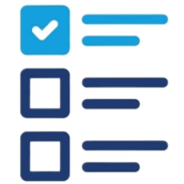
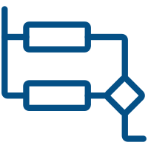


GenAI Solutions follow a similar high-level ‘workflow’
1. Envision & Configure Your Solution
Define your Use Case, prepare your Data, and configure your solution
7. Deliver a High-Quality Response
2. Understand the User’s Request
Present your response to your user while delivering a high-quality, personalized experience
Leverage Natural Language Processing to:
Understand your user’s intent
Break-down complex requests
Identify the user’s sentiment
6. Check for Quality and ‘Toxicity’
High-Level
GenAI
Flow
3. Route the Request(s)
Review your response for ‘hallucinations’, misspellings, inappropriate language, etc.
prior to providing it to your user
Route the user’s request(s) to the resources needed to fulfil them, including:
Data Sources
Analytical Models
Advanced Services
5. Generate a Targeted Response
4. Aggregate Required Data & Context
Generate an integrated, personalized
response to your user’s request
Consolidate the output from your various requests and provide it as critical context to generate your response

Slide 5
Q&A

Slide 6
Coding Exercise
> No coding excercise

